Slide 1
Supervised Learning

Slide 2
An example application
An emergency room in a hospital measures 17 variables (e.g., blood pressure, age, etc) of newly admitted patients.
A decision is needed: whether to put a new patient in an intensive-care unit.
Due to the high cost of ICU, those patients who may survive less than a month are given higher priority.
Problem: to predict high-risk patients and discriminate them from low-risk patients.

Slide 3
Another application
A credit card company receives thousands of applications for new cards. Each application contains information about an applicant,
age
Marital status
annual salary
outstanding debts
credit rating
etc.
Problem: to decide whether an application should approved, or to classify applications into two categories, approved and not approved.

Slide 4
Machine learning and our focus
Like human learning from past experiences.
A computer does not have “experiences”.
A computer system learns from data, which represent some “past experiences” of an application domain.
Our focus: learn a target function that can be used to predict the values of a discrete class attribute, e.g., approve or not-approved, and high-risk or low risk.
The task is commonly called: Supervised learning, classification, or inductive learning.

Slide 5
The data and the goal
Data: A set of data records (also called examples, instances or cases) described by
k attributes: A₁, A₂, … A_{k}.
a class: Each example is labelled with a pre-defined class.
Goal: To learn a classification model from the data that can be used to predict the classes of new (future, or test) cases/instances.

Slide 6
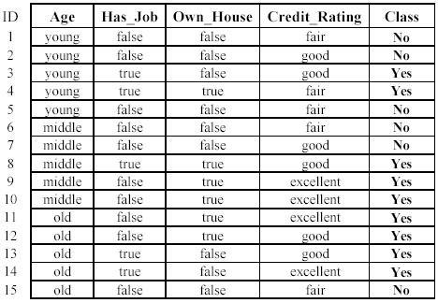
An example: data (loan application)

Slide 7
An example: the learning task
Learn a classification model from the data
Use the model to classify future loan applications into
Yes (approved) and
No (not approved)
What is the class for following case/instance?

Slide 8
Supervised vs. unsupervised Learning
Supervised learning: classification is seen as supervised learning from examples.
Supervision: The data (observations, measurements, etc.) are labeled with pre-defined classes. It is like that a “teacher” gives the classes (supervision).
Test data are classified into these classes too.
Unsupervised learning (clustering)
Class labels of the data are unknown
Given a set of data, the task is to establish the existence of classes or clusters in the data

Slide 9
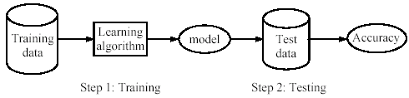
Supervised learning process: two steps
Learning (training): Learn a model using the training data
Testing: Test the model using unseen test data to assess the model accuracy

Slide 10
What do we mean by learning?
Given
a data set D,
a task T, and
a performance measure M,
a computer system is said to learn from D to perform the task T if after learning the system’s performance on T improves as measured by M.
In other words, the learned model helps the system to perform T better as compared to no learning.

Slide 11
An example
Data: Loan application data
Task: Predict whether a loan should be approved or not.
Performance measure: accuracy.
No learning: classify all future applications (test data) to the majority class (i.e., Yes):
Accuracy = 9/15 = 60%.
We can do better than 60% with learning.

Slide 12
Fundamental assumption of learning
Assumption: The distribution of training examples is identical to the distribution of test examples (including future unseen examples).
In practice, this assumption is often violated to certain degree.
Strong violations will clearly result in poor classification accuracy.
To achieve good accuracy on the test data, training examples must be sufficiently representative of the test data.

Slide 13
Decision trees
Decision tree learning is one of the most widely used techniques for classification.
Its classification accuracy is competitive with other methods, and
it is very efficient.
The classification model is a tree, called decision tree.
C4.5 by Ross Quinlan is perhaps the best known system

Slide 14
The loan data (reproduced)

Slide 15
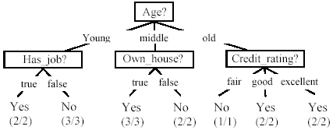
A decision tree from the loan data
Decision nodes and leaf nodes (classes)

Slide 16

Use the decision tree
No

Slide 17

Evaluating classification methods
Predictive accuracy
Efficiency
time to construct the model
time to use the model
Robustness: handling noise and missing values
Scalability: efficiency in disk-resident databases
Interpretability:
understandable and insight provided by the model
Compactness of the model: size of the tree, or the number of rules.

Slide 18
Evaluation methods
Holdout set: The available data set D is divided into two disjoint subsets,
the training set D_{train} (for learning a model)
the test set D_{test} (for testing the model)
Important: training set should not be used in testing and the test set should not be used in learning.
Unseen test set provides a unbiased estimate of accuracy.
The test set is also called the holdout set. (the examples in the original data set D are all labeled with classes.)
This method is mainly used when the data set D is large.

Slide 19
Evaluation methods (cont…)
n-fold cross-validation: The available data is partitioned into n equal-size disjoint subsets.
Use each subset as the test set and combine the rest n-1 subsets as the training set to learn a classifier.
The procedure is run n times, which give n accuracies.
The final estimated accuracy of learning is the average of the n accuracies.
10-fold and 5-fold cross-validations are commonly used.
This method is used when the available data is not large.

Slide 20
Evaluation methods (cont…)
Leave-one-out cross-validation: This method is used when the data set is very small.
It is a special case of cross-validation
Each fold of the cross validation has only a single test example and all the rest of the data is used in training.
If the original data has m examples, this is m-fold cross-validation

Slide 21
Evaluation methods (cont…)
Validation set: the available data is divided into three subsets,
a training set,
a validation set and
a test set.
A validation set is used frequently for estimating parameters in learning algorithms.
In such cases, the values that give the best accuracy on the validation set are used as the final parameter values.
Cross-validation can be used for parameter estimating as well.

Slide 22
Classification measures
Accuracy is only one measure (error = 1-accuracy).
Accuracy is not suitable in some applications.
In classification involving skewed or highly imbalanced data, e.g., network intrusion and financial fraud detections, we are interested only in the minority class.
High accuracy does not mean any intrusion is detected.
E.g., 1% intrusion. Achieve 99% accuracy by doing nothing.
The class of interest is commonly called the positive class, and the rest negative classes.

Slide 23
Back propagation
Back propagation is a systematic method for training multiple-layer ANNs.
The standard back propagation algorithm is as follows :
Build a network with a chosen number of input, hidden and output units.
Initialize all the weights to low random values
Choose a single training pair at random
Copy the input pattern to the input layer
Cycle the network so that the activations from the inputs generate the activations in the hidden and output layers
Calculate the error derivative between the output activation and the target output.
Back propagate the summed products of the weights and errors in the output layer in order to calculate the error in the hidden units.
Update the weights attached to each unit according to the error in that unit, the output from the unit below it, and the learning parameters, until the error is sufficiently low or the network settles.

Slide 24
Conclusion
Applications of supervised learning are in almost any field or domain.
There are numerous classification techniques.
There are still many other methods, e.g.,
Bayesian networks
Neural networks
Genetic algorithms
Fuzzy classification
This large number of methods also show the importance of classification and its wide applicability.
It remains to be an active research area.

Slide 25
THANK YOU !!!

